Slide 1
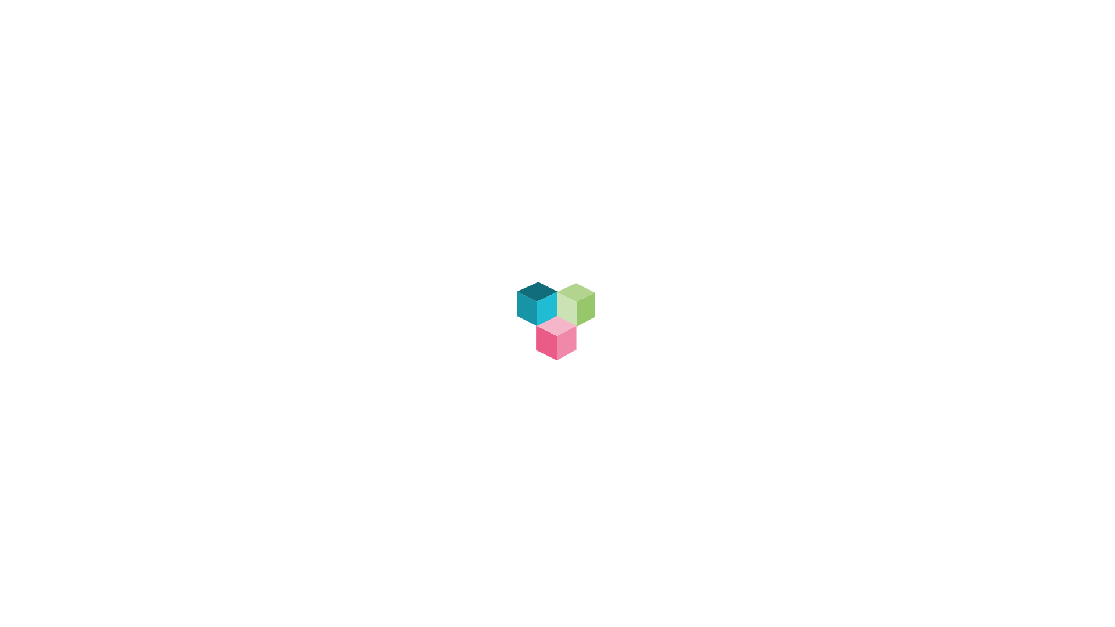
Hitaya DApp
Base234

Slide 2
TIMELINE
1
Introduction
2
Primary Goals Of The Application
3
Technology Used
4
Future Scope

Slide 3
INTRODUCTION
Hitaya DApp is derived from a Sanskrit word which means Welfare.​
Hitaya DApp primary focus is to enable users belonging to an organization to transfer tokens or (HAT Tokens) which will be widely accepted in the organization as a form of coupons/currency in organization canteen, gyms or malls, or users can transfer this tokens among its peers or swap it with other tokens or currency, save contacts in blockchain, and view income/expenditure in a dashboard.
It can also be used to get soft loans from other peers belonging to the same organization.
Employee can do monthly health diagnosis, doctor appointment using Advance AI/ML HealthCare ML Models
Application Can be widely Divided into
Hitaya Wallet
Hitaya Finance
Hitaya HealthCare

Slide 4
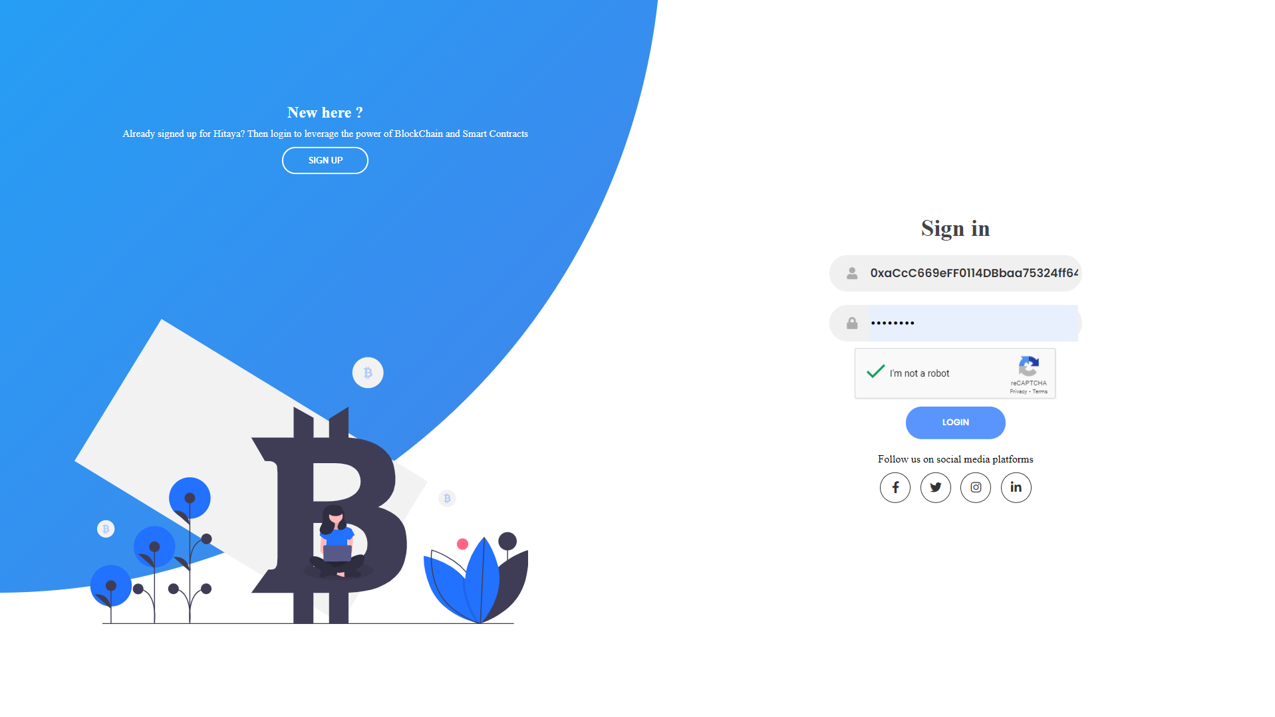

Slide 5
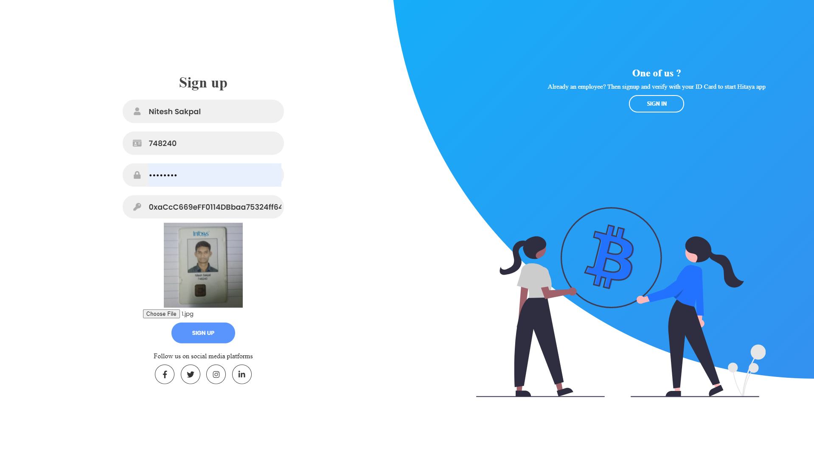

Slide 6
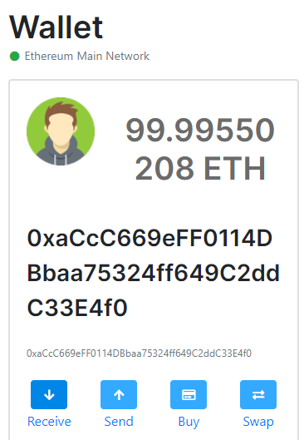

wallet

Slide 7
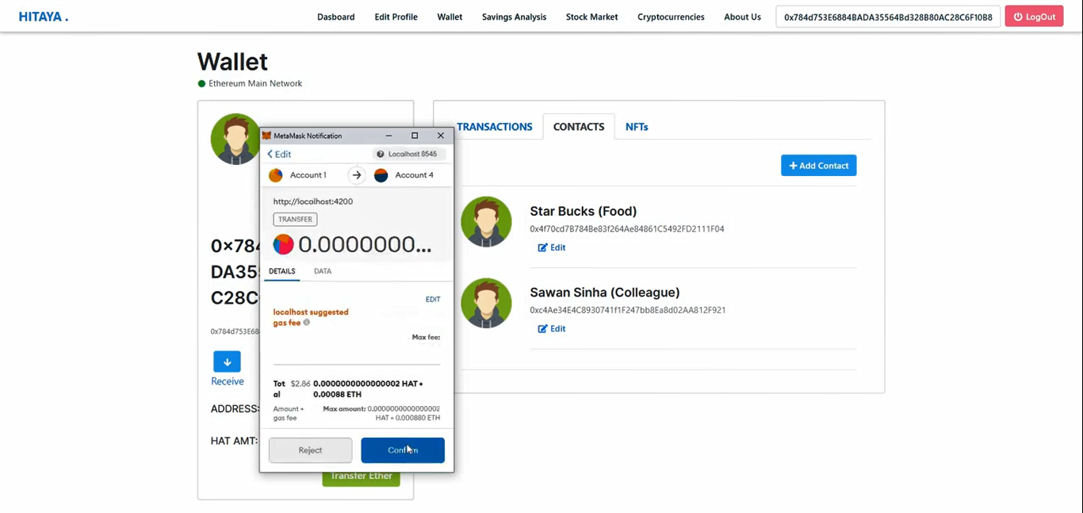
USER WALLET

Slide 8
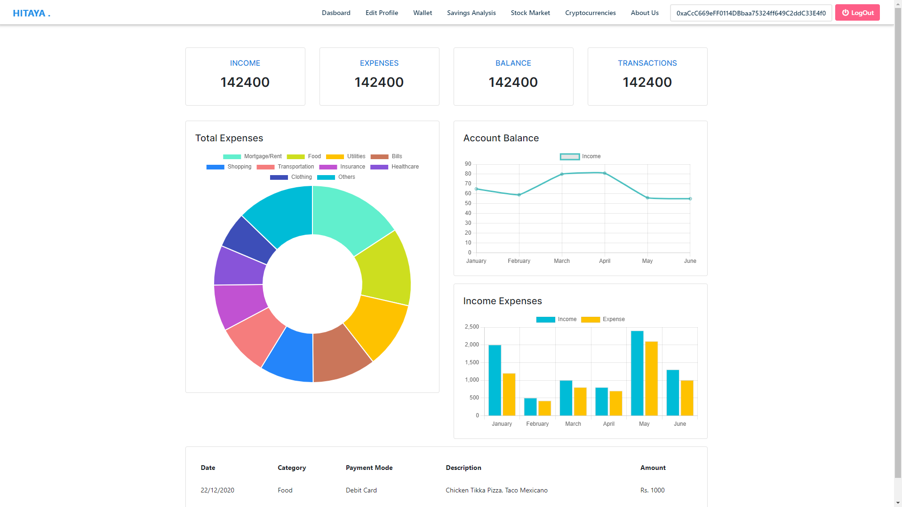
USER Dashboard

Slide 9
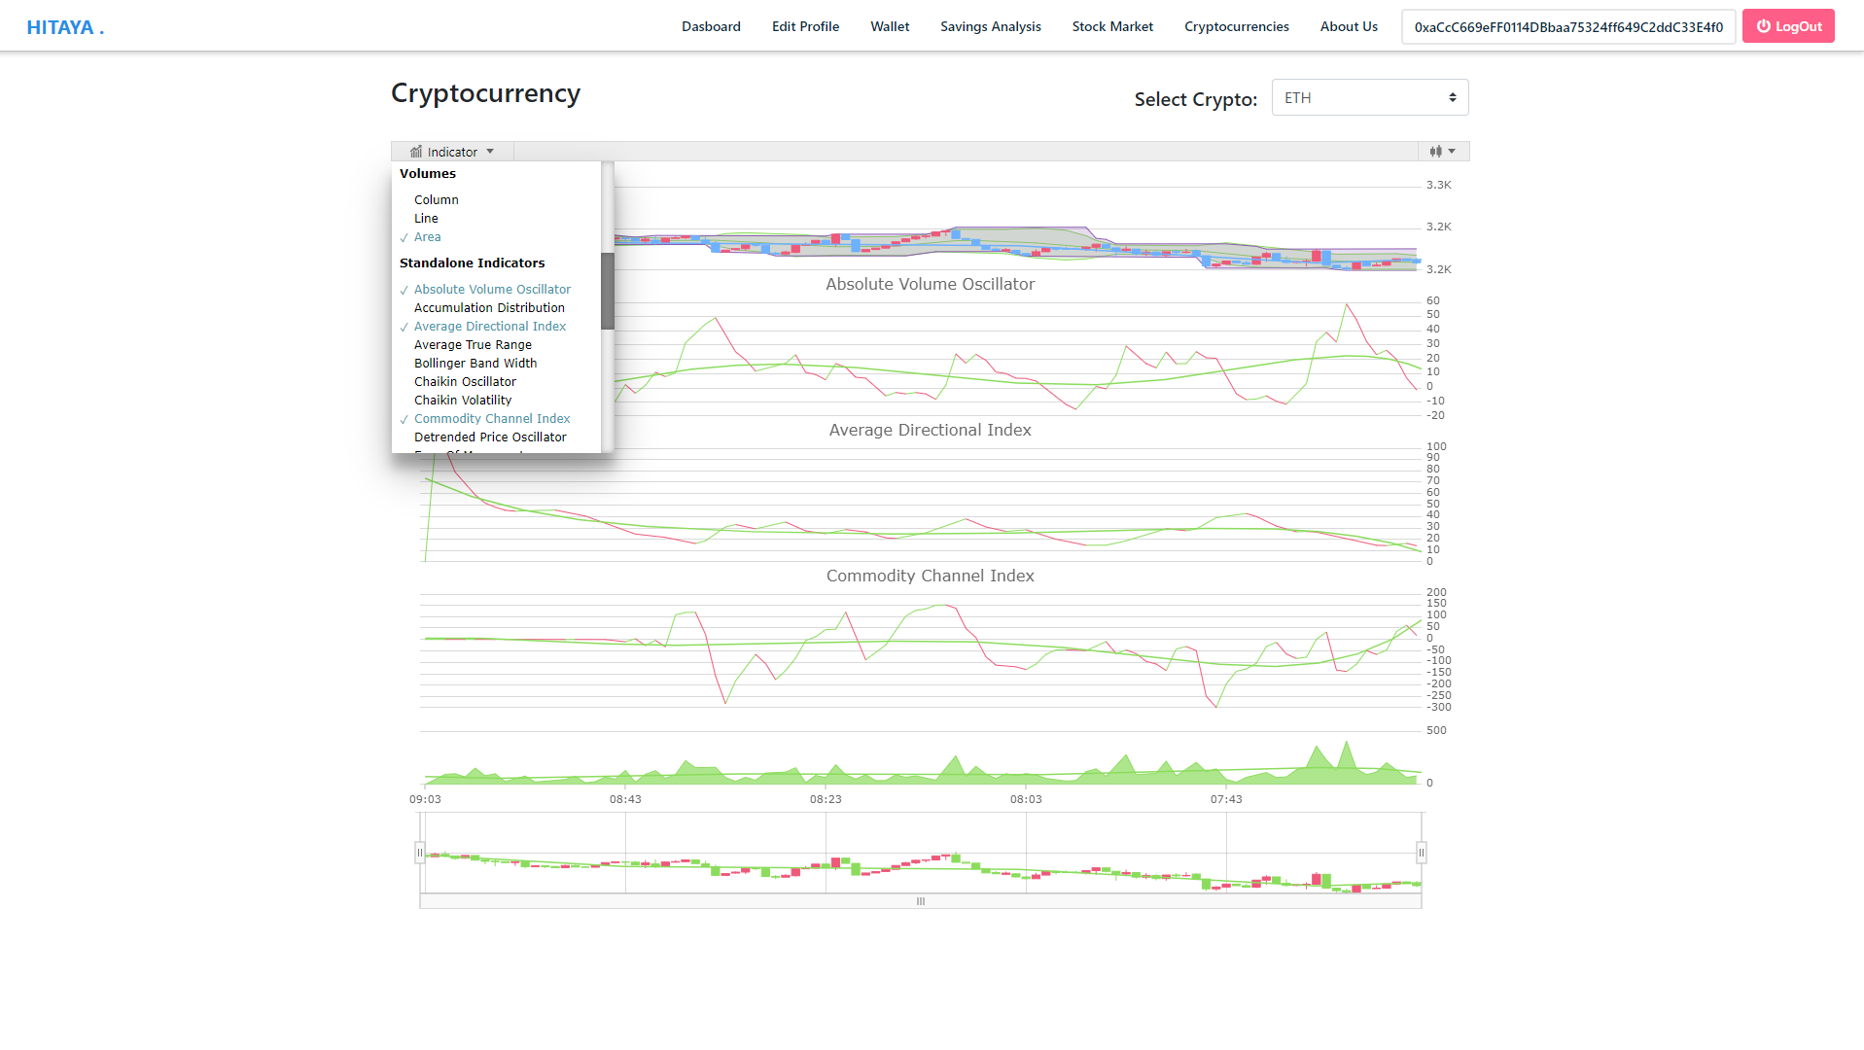
CRYPTO PRICE CHECKER

Slide 10
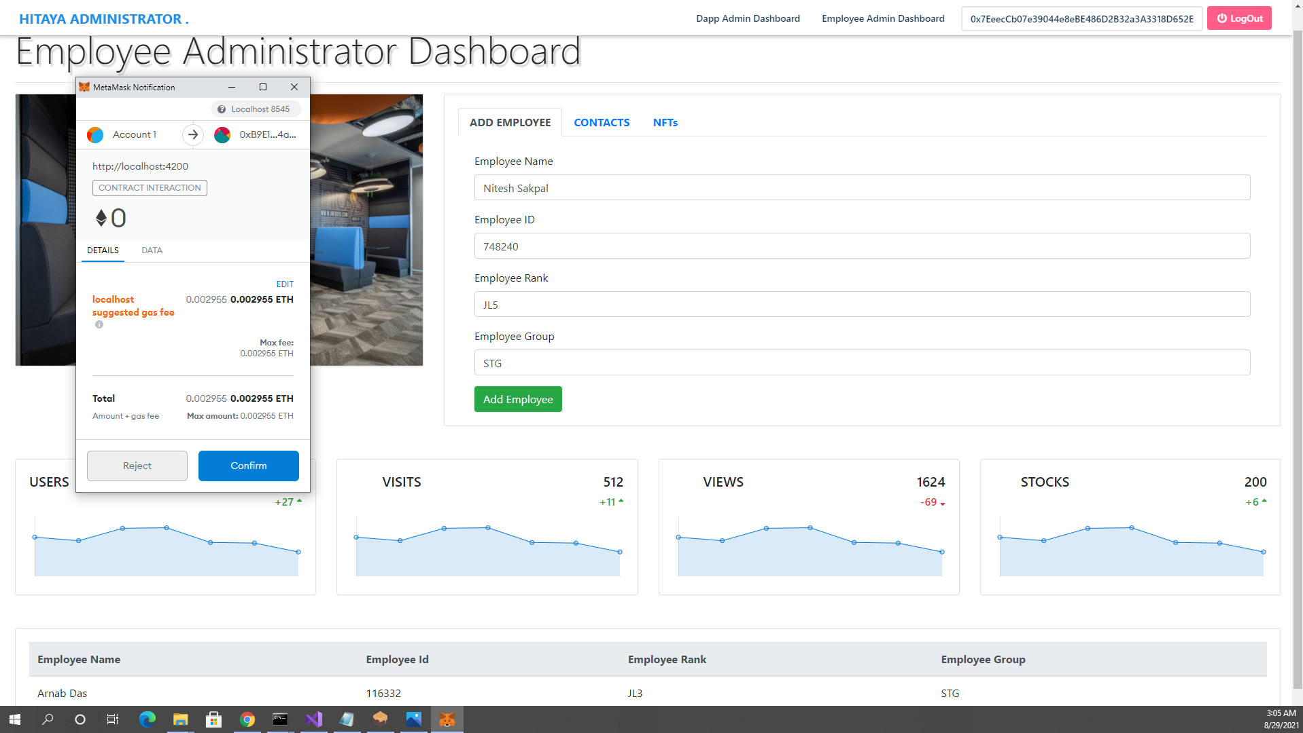
HITAYA EMPLOYEE ADMIN

Slide 11
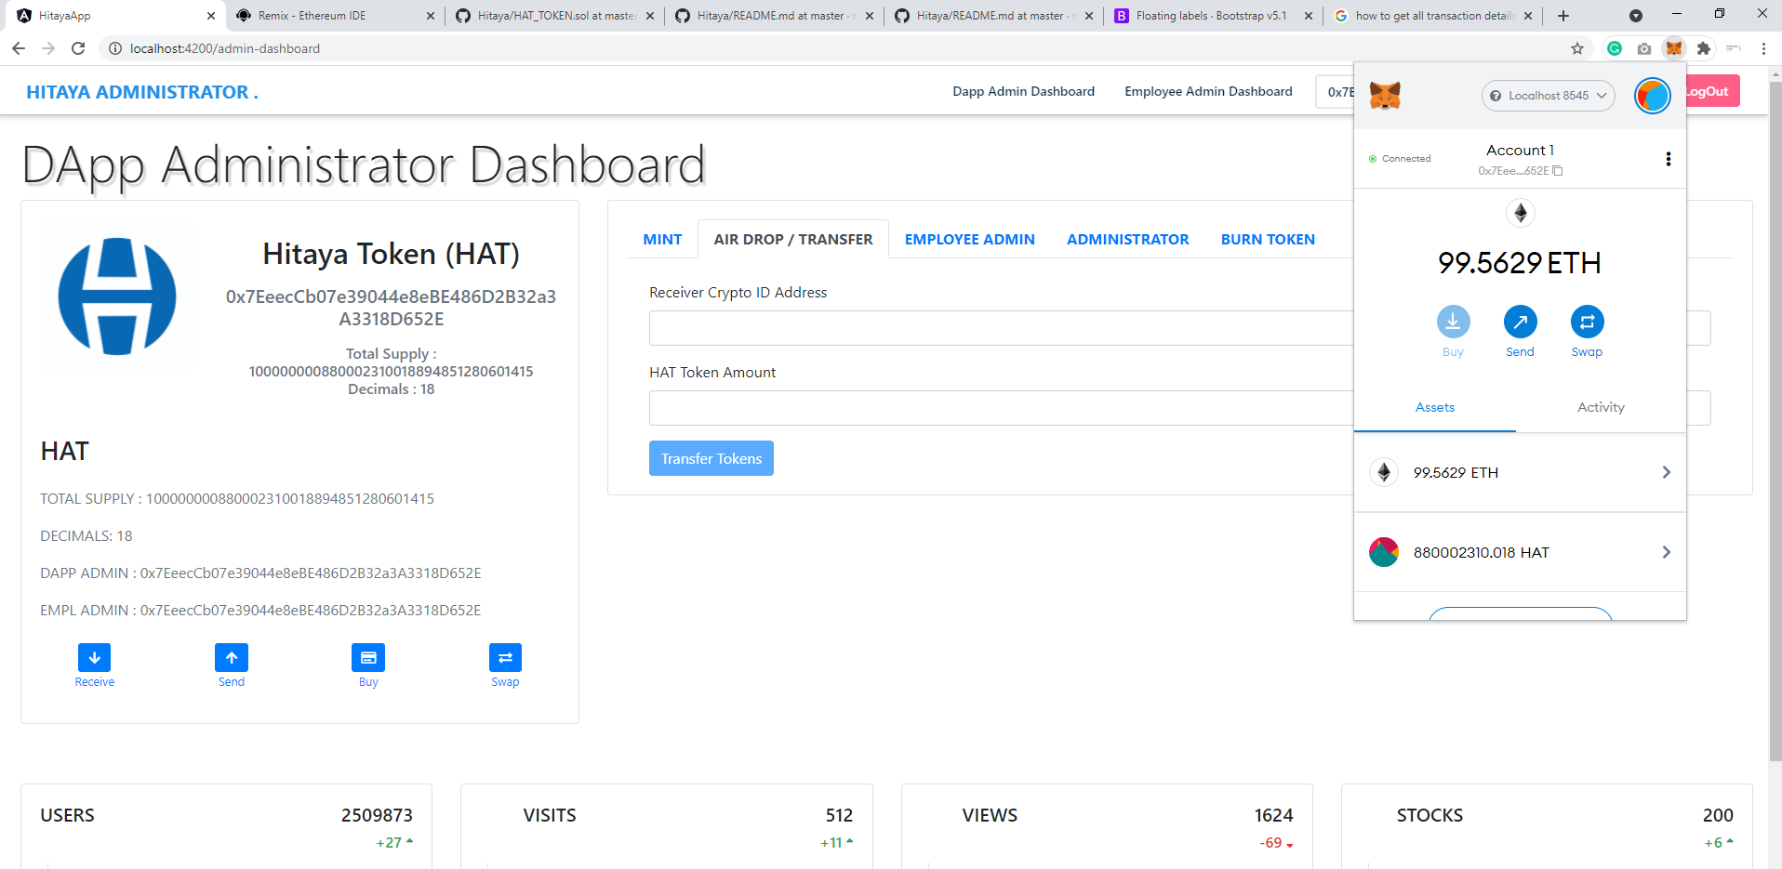
HITAYA DAPP ADMIN

Slide 12
HITAYA FINANCE​
A user can ask for loan (HAT Tokens) from his colleague/friend within an organization at a fixed interest rate.
The Colleague can accept/reject/negotiate the interest rate and the timeline of the loan repayment.
If both parties agree a loan is sanctioned from the smart contract.
And the loan repayment is done by the deducting the amount from monthly salary of the employee after calculating the Monthly payment from the Time, and Interest Rate of loan Repayment.
All benefit from the agreement as the loan taker can get a lower interest rate on loan, than been charged by the traditional banking System.
And the loan giver can earn a higher interest on their money, than saving it in the traditional banks systems.

Slide 13
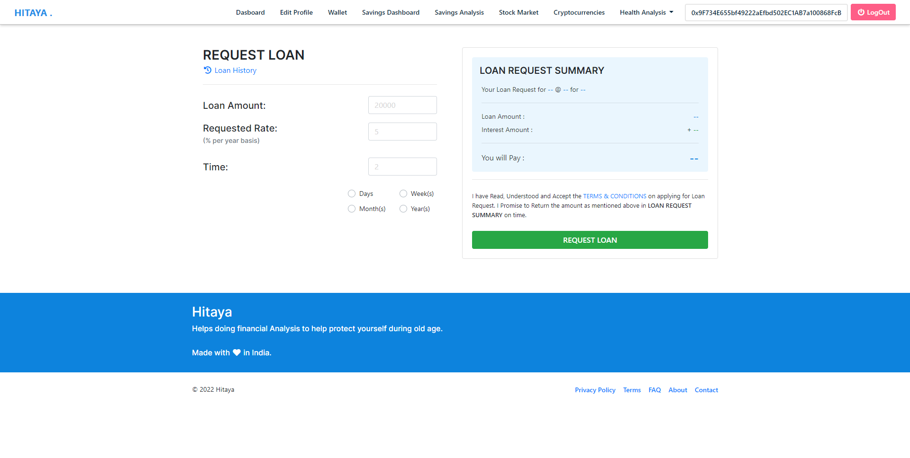
REQUEST LOAN

Slide 14
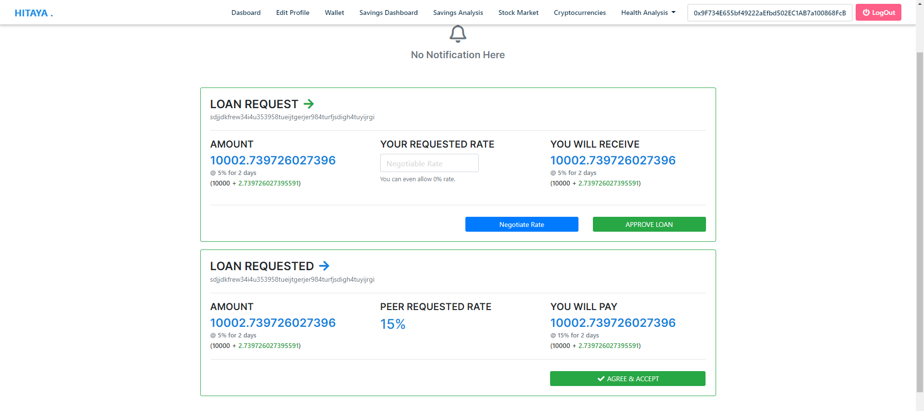
LOAN ACCEPT/REJECT/NEGOTIATE

Slide 15
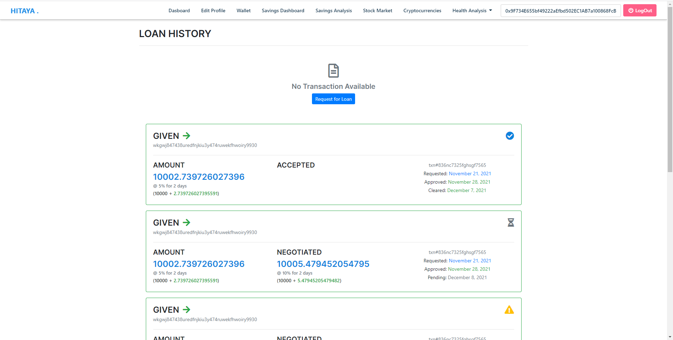
LOAN HISTORY

Slide 16
HITAYA HEALTHCARE
A user can perform initial Diagnosis based on their reports.
A User can book doctor Appointment.
All Health Data will be stored in blockchain thus ensuring security
.

Slide 17
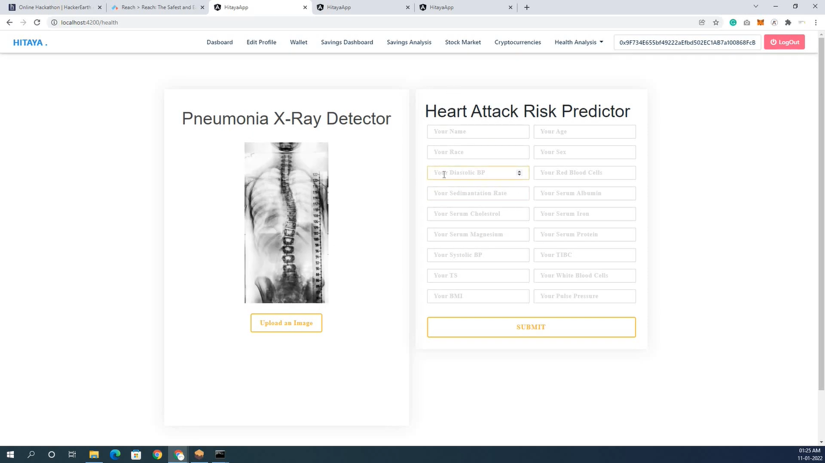
Hat ai healthcare

Slide 18
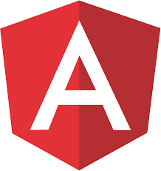
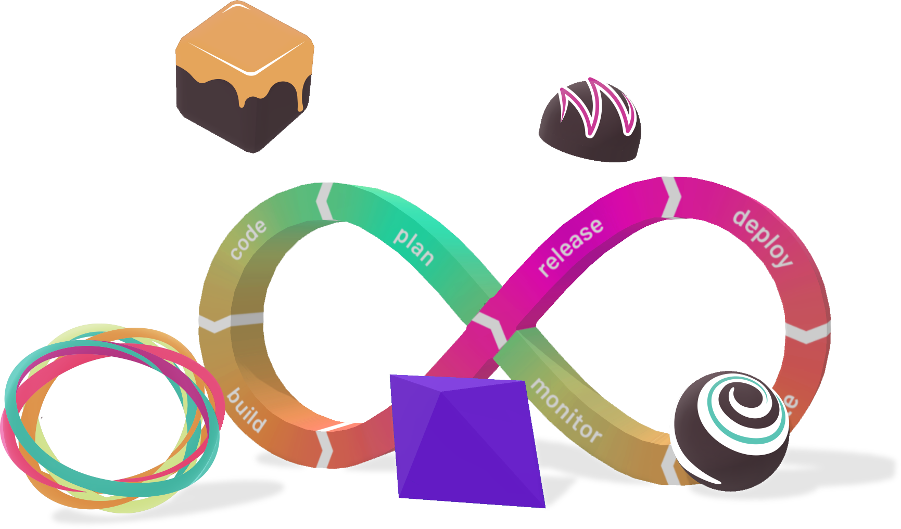
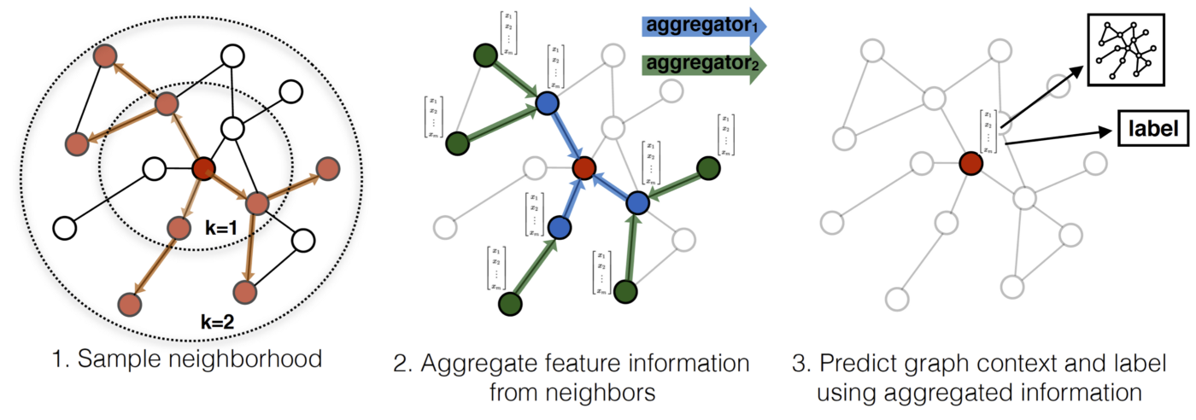
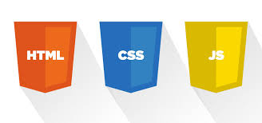
TECHNOLOGIES USED IN THE APPLICATION
FRONT END
ANGULAR
HTML
CSS
JAVASCRIPT
OCR USING ML
BACKEND
Web3.js
TRUFFLE
GANACHE
REACH
ETHEREUM
PYTHON
FAST API
TENSORFLOW
(Graph Neural Network)

Slide 19
FUTURE SCOPE .​

Slide 20
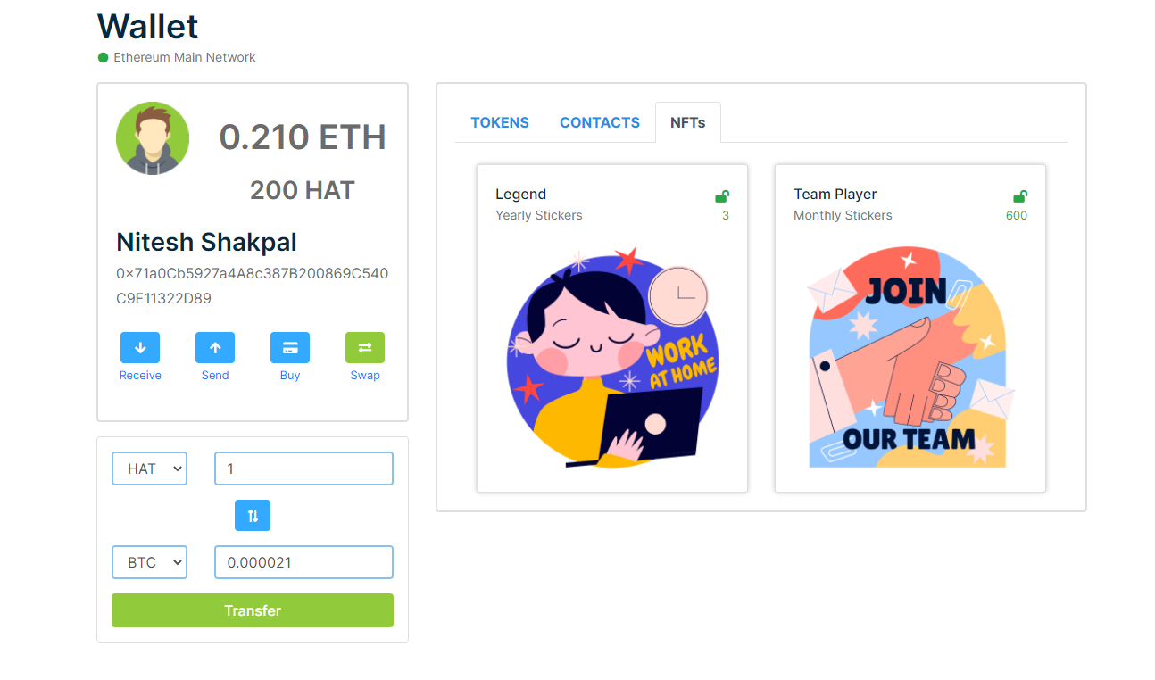
IMPLEMENTING NFTs
NFTs
Employee Admin can transfer NFTs to employees based on Weekly / Monthly / Yearly performance.​
Users can sell / auction this Tokens on HAT exchange with other users.

Slide 21
SUMMARY
Thanks for conducting this hackathon, It was a wonderful learning experience in the field of blockchain and all the issues ALGORAND solves.

